Slide 1
Election 2020: Potential Impacts Financial Services
Ron Klein│ Kara Ward│ Scott Mason
October 6, 2020
Notes:
Stephanie kicks off with housekeeping

Slide 2
Thank you for joining today’s program
All participants are on mute
Please ask questions via Q&A box
Today’s program is being recorded and will be posted on our website
For technical assistance please reach out to the host via the chat box

Slide 3
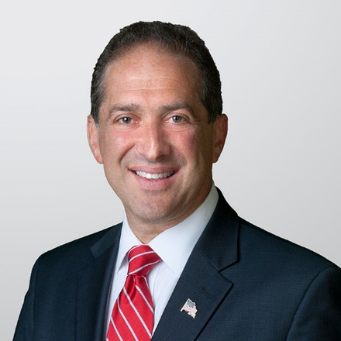
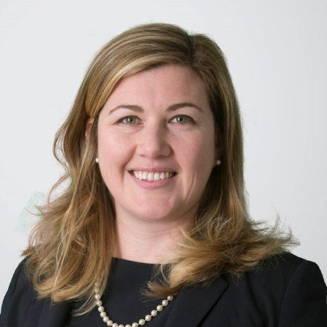
Speakers
Ron Klein
Partner
Kara Ward
Partner
Scott Mason
Senior Policy Advisor
Notes:
Ron - introduction

Slide 4
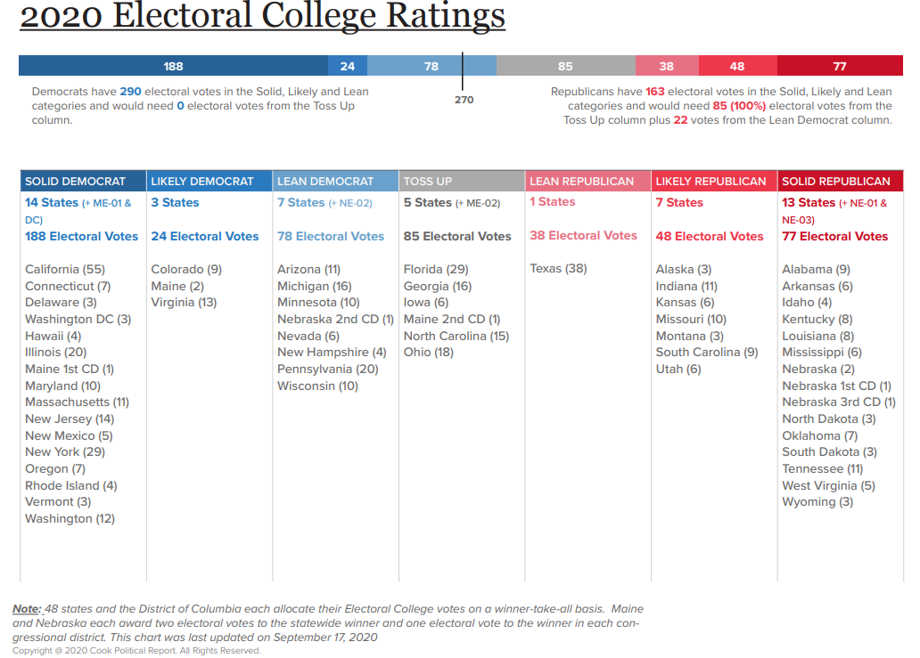
Electoral College Math Matters Most
538 Total Electoral College Votes; Need majority to win (270 votes)
In 2016, Trump won electoral vote 304-227, lost the popular vote by 2.1 points
Cook’s Latest Scenario:
290– Biden/Democratic
85 - Toss Up
163 - Trump/Republican
Notes:
Scott to cover

Slide 5
How Long Can Uncertainty Last?: Timeline
Nov 3: Election Day
Dec 8: State recount deadline
Dec 14:
Meeting of Electors
Dec 23:
Deadline for elector ballots
Jan 3: New Congress sworn-in
Jan 6: Counting of Electoral ballots (U.S. Congress meets)
Jan 20: Inauguration Day
Notes:
Kara to cover; Scott to chime in

Slide 6
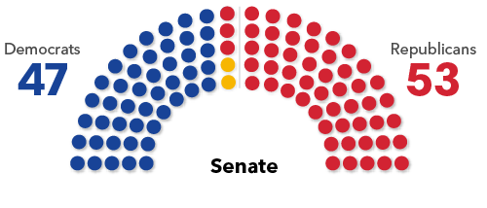
Senate Balance of Power
Trump’s re-election outlook and each party’s ability to field strong candidates are key
If Democrats net four seats they would take control of the Senate; netting three seats would result in a presumptive tie; the Vice President casts a deciding vote in the Senate where a majority vote is required
Democrats last defeated more than two Republican senators in 2008, when Barack Obama’s victory helped Democrats beat five GOP incumbents
Notes: Two independent senators (Bernie Sanders (VT) and Angus King (ME) caucus with the Democrats.
Notes:
Scott

Slide 7
Senate Forecast
Solid Democratic
Solid Republican
Toss up
Likely Democratic
Likely Republican
No race
Lean Democratic
Lean Republican
Wash.
Mont.
Maine
N.D.
Vt.
Ore.
Minn.
N.H.
Idaho
S.D.
Wis.
N.Y.
Mass.
Wyo.
Mich.
R.I.
Pa.
Conn.
Neb.
Iowa
N.J.
Nev.
Ill.
Ind.
Ohio
Del.
Utah
W.Va.
Md.
Calif.
Colo.
Kan.
Va.
Mo.
Ky.
Tenn.
N.C.
Ariz.
Okla.
Ark.
S.C.
N.M.
Miss.
Ala.
Ga.*
Note: *Georgia’s regular election is rated a toss-up, the special election is rated Leans Republican
Source: Race ratings from Cook Political Report; as of July 23
Texas
La.
Alaska
Fla.
Hawaii
Notes:
Scott

Slide 8
New Faces on the Senate Banking Committee
Democrats | Republicans
Sen. Brown (D-OH) to remain | Sen. Crapo (R-ID) likely to leave for Senate Finance
Sen. Warren (D-MA) likely to remain (for now) | Sen. Toomey (R-PA) assumed to take leadership; Sen. Scott (R-SC) to follow after 2 years
Seat in Contention: Sen. Jones (D-AL) | Several seats in contention: Sen Tillis (R-NC); Sen Perdue (R-GA); Sen McSally (R-AZ)
Notes:
Ron will cover

Slide 9
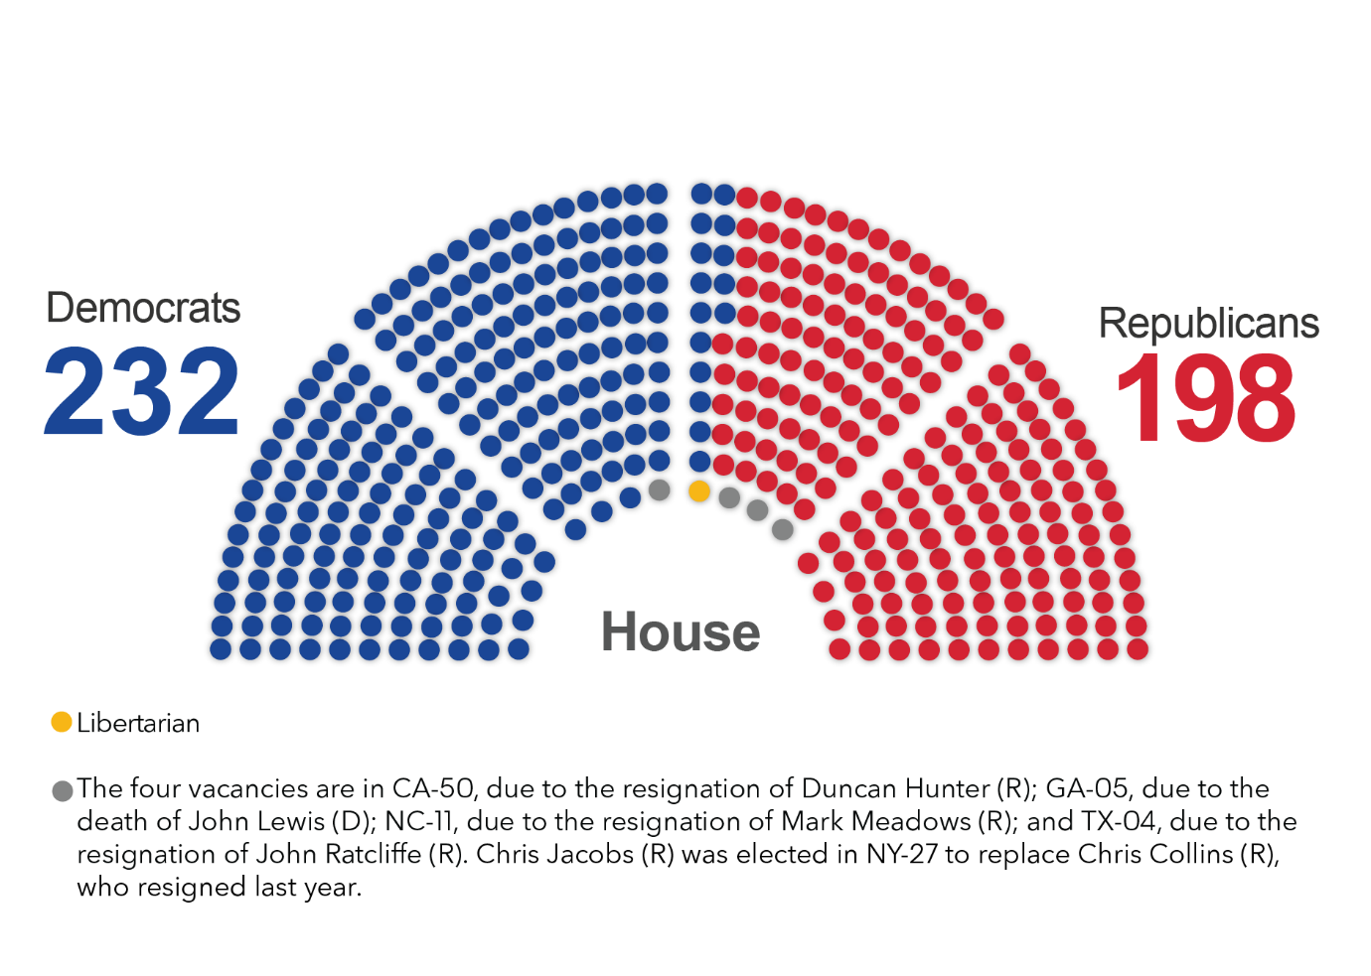
House Balance of Power
Notes:
Ron; Scott will chime in

Slide 10
New Faces: House Financial Services
Democrats | Republicans
Rep. Waters (D-CA) to remain | Rep. McHenry (R-NC) likely to remain
New Housing Subcommittee lead | Republican Term Limits
Notes:
Ron will cover

Slide 11
Trump Administration: Who Stays? Who Goes?
NEC: Larry Kudlow and Peter Navarro likely to stay
Treasury: Mnuchin likely to leave
Potential replacements: Rep French Hill (R-AR);
OCC: Brian Brooks to be nominated officially
HUD: Carson likely to leave
Potential replacement: Current Dep Sec Brian Montgomery;
FHA Commission: Dana Wade likely to stay
Attorney General: William Barr likely to stay
CFPB: Kathy Kraninger to stay
FHFA: Mark Calabria to stay
SEC: Pierce term expires in 2025; Crenshaw’s term expires in 2024; Clayton’s term expires 2021; Roisman’s term expires 2023; Lee’s expires 2022
Fed: Chairman Jerome Powell's term expires in Feb 2022
Vice Chair of Supervision Randy Quarles' term expires in Oct 2021
Notes:
Scott

Slide 12
What if Biden Wins?
Should VP Biden win the election, it is likely that the House and Senate will be Democratic
Only 7% of voters “split ticket” vote
Democrats may move the vote threshold to 51 votes (eliminate filibuster rules) = easier to pass legislation and nominations.
Early Legislative Actions:
COVID relief legislation
Large Infrastructure Package
Broadband access expansion changes where people live & work?
Big Thinking
Criminal Justice Reform
Economic Inequality
Taxes
Childcare and Healthcare costs
Notes:
Ron to cover

Slide 13
Biden Administration- People are the Policies
“Highly Speculative” List of Appointees
Timing = Spring/Summer 2021 after the first 50 Cabinet spots
NEC: Lael Brainard, Sarah Bloom Raskin
Treasury: Jamie Dimon (JPM), Richard Cordray (former CFPB), Neel Kashkari (Fed Minn), Sen Elizabeth Warren (D-Mass.)- less likely immediately, Roger Ferguson (Fed and TIAA)
HUD: Eric Garcetti (Mayor of LA) or Reps. Karen Bass (D-Calif.),Chuy García (D-Ill.), Sarah Rosen Wartell. FHA: Ed Golding, Alanna McCargo
Attorney General: Sen. Amy Klobuchar (D-Minn.); Preet Bharara, Stacey Abrams, Meg Whitmore or Sally Yates
CFPB: Warren Alums: Rep Katie Porter (D-CA), Bharat Ramamurti
FHFA: Mark Zandi, Jim Parrott
Complications with the Director/Conservator split.
Notes:
Kara to cover

Slide 14
Biden Administration- Legislation: What could happen?
Focus on Banking/Financial Services:
OCC FinTech charters and federal pre-emption in banking
Small business lending, CDFIs and MDIs
Credit Score, Credit Bureau
Basel III and Capital requirements
Fair Lending- disparate impact
Housing:
No real GSE reform movement in 2021 or 2022.
Reform on the edges:
Forbearance discussions driving further thinking
Multi-family rental support and eviction moratoriums
Direct Oversight of counterparties (Servicers, etc)
Notes:
Kara to cover

Slide 15
Biden Administration- Regulatory: What Changes? What Stays the Same?
Topic | Stays the Same | Changes
Housing | QM policy: APOR + 200 bps rule; Forbearance window; FHA IT updates; No FHLB eligibility for non-banks | Credit access for LMI; FHA: Life of loan; manual underwriting; Multi-family eviction moratoriums during pandemic
COVID-related | Fed and Treasury Lending Facilities | New PPP program; Congressional mandated multi-family or Commercial real estate facility; Rental and foreclosure relief; CDFI/MDI subsidized lending increase
FinTech | Revolutionary chartering of non-depositories; continued rise of non-bank lenders capital concerns | Application of fair lending; OCC v state AG on preemption issues (Midland and mortgage servicing)
CRA | Fed proposal and similar to status quo become law | OCC prior to implementation date
Bank Capital | Pandemic-related CBLR waivers; Bank dividend restrictions; CECL; Capital proposals- Basel III and stable funding | Increased focus on stress testing and Fed recommendations
FSOC | SIFI | Reversal of focus on “activities”. Focus on “entities” GSEs and major non-bank lenders
Cannabis Banking | SAFE Act ragged edges on insurance | Adoption of SAFE Act (not near term)
SEC | Cautious pursuit of crypto- tension with CFTC and banking interests; | EU policy driving
Notes:
Kara to cover

Slide 16
Biden Administration- Regulatory: What Changes? What Stays the Same?
Topic | Stays the Same | Changes
Credit Score | Efforts for reform | Potential for Federal score or bureau
Cross-Border Investment | China concerns | CFIUS policy
AML-BSA | Reform and streamlining efforts
Bankruptcy |  | Student loan treatment; Potential for wholesale consumer changes.
Notes:
Kara to cover

Slide 17
2020 Key Deadlines and Expirations
End date | Program
Sept. 30 | Fiscal 2020 funding, as well as other major programs expire
Nov. 30 | Health extenders, Temporary Assistance for Needy Families program
Dec. 6 | Extra $300 per week federal pandemic unemployment benefit
Dec. 11 | CR expires, New PPP?
Dec. 31 | Tax extenders and several coronavirus response programs, including: Student loan repayment and interest accrual suspension Emergency sick, family leave, and other pandemic unemployment assistance programs Federal payroll tax payment deferral for employees
Notes: Pandemic-related programs include those created or extended by executive order. Education authorizations are automatically extended for one year under the General Education Provisions Act if Congress doesn’t act. $300 pandemic unemployment benefit could expire sooner if disaster relief funds run out. FAST — Fixing America’s Surface Transportation
Notes:
Scott to cover

Slide 18
Questions?
Notes:
Ron moderating

Slide 19
Thank You

Slide 20
Ron Klein
Ron Klein, a member of Holland & Knight's Public Policy & Regulation Group, has worked in the private sector as a business and transactional attorney for over 25 years and in the public sector as an elected official in both Tallahassee and Washington, D.C. This experience offers a distinctive combination of skill sets in having worked and advised private sector principals and management legal issues, as well as having served in the Florida House, Senate and U.S. House of Representatives. Mr. Klein's experience gives clients an added edge in having their advocate understand their issues and concerns, as well as the knowledge, resources, and relationships to help them make the best strategic business decisions.
In 2006, Mr. Klein was elected as Congressman to represent Florida's 22nd Congressional District (Broward and Palm Beach Counties), wherein he served two terms continuing his focus on business development, healthcare and energy issues. He served on the full Financial Services Committee, with membership on Capital Markets, Insurance and Government Sponsored entities (Fannie, Freddie); subcommittee on Financial Institutions and Consumer Credit; and the Subcommittee on Oversight and Investigations.
He was an active participant in the drafting, development and negotiation of the Dodd-Frank Wall Street Reform and Consumer Protection Act and the Comprehensive Iran Sanctions Accountability and Divestment Act of 2010, including continued oversight and follow up with staff and agencies. He also co-chaired the New Democrat Coalition Energy Task Force which, with a broad coalition of industry, environmental, and consumer groups, led the effort to pass energy policy based on robust investment in research and development, the development of energy efficient products and services and the use of incentives to encourage market certainty.
Mr. Klein's practice at Holland & Knight includes advising clients in how to anticipate, consider, analyze and navigate rules, regulations and compliance in the financial services, healthcare and energy sectors. He will also work in the areas of international business and trade.
Partner
Washington, D.C.
202.469.5152
Ron.Klein@hklaw.com

Slide 21
Kara Ward
Kara Ward is a Washington, D.C., attorney and member of Holland & Knight's Public Policy & Regulation Group. Ms. Ward focuses her practice on financial services and the housing finance market. She has experience with issues related to housing finance reform, servicing, insurance, consumer financial services, blockchain and community economic development.
Combining federal and private practice experience, Ms. Ward provides various financial service companies and trade group clients with policy analysis and strategic advice to advance their business objectives on Capitol Hill and in the Executive branch.
Ms. Ward frequently works on issues involving the U.S. House Financial Services Committee, U.S. Senate Banking Committee, U.S. Department of the Treasury, Consumer Financial Protection Bureau (CFPB), Federal Housing Finance Agency (FHFA), U.S. Department of Housing and Urban Development (HUD), Federal Deposit Insurance Corporation (FDIC) and the U.S. Federal Reserve System.
Ms. Ward also is involved in emerging issues around the use of blockchain in financial services contexts. From cryptocurrency, initial coin offerings and the theory of utility tokens, Ms. Ward is active in the public policy space relating to the future regulatory structures related to this asset class.
Ms. Ward has worked extensively on efforts to reform the single-family residential housing system, representing a number of client interests in recent legislative proposals. She also has broad experience with consumer financial issues and helps clients provide input into rule-making by the CFPB.
Prior to entering private practice, Ms. Ward was an attorney with the Treasury Department during the economic crisis. She focused on, among other topics, community development financial institutions, tax credit programs, the creation of the Federal Insurance Office (FIO), the Financial Stability Oversight Council (FSOC), funding for small business development and other federal grant programs.
Partner
Washington, D.C.
202.469.5487
Kara.Ward@hklaw.com

Slide 22
Scott Mason
Scott D. Mason focuses on the intersection between Capitol Hill and the Trump Administration on major policy initiatives, including tax reform, healthcare reform, immigration, infrastructure initiatives and other key priorities.
Mr. Mason served as the director of congressional relations for Donald J. Trump for President Inc. and subsequently the President-Elect Transition Team. Mr. Mason was one of the original members of Trump's Washington campaign team, joining the effort in March 2016 and maintains relationships with many members of the campaign team now serving in the Trump Administration.
Prior to joining the Trump campaign, Mr. Mason served as vice president government affairs for home improvement retailer Lowe's Companies Inc., leading the local, state and federal government affairs program from 2005-2015. In this role, he represented the Fortune 50 company on issues involving trade, tax, healthcare, energy, labor and financial services. He successfully established the Lowe's brand on Capitol Hill, adding an important retail voice on the broad array of internal and customer-related issues facing the company.
Mr. Mason has served in senior public and government affairs roles in Washington, D.C., North Carolina, Florida and Texas for more than 25 years. He also has grassroots, government affairs and public affairs experience with several major trade associations and other large corporations, including Anheuser-Busch, Samsung North America, the United Services Automobile Association (USAA), the Beer Institute and the American Medical Association
Senior Policy Advisor
Washington, D.C.
202.469.5330
Scott.Mason@hklaw.com

