Slide 1


Slide 2
Welcome!

Slide 3

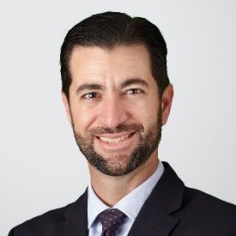


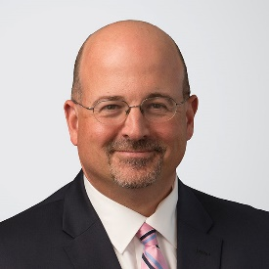
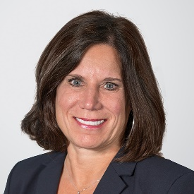
Moderator/Presenters
Leonard “Len” Bernstein
Partner | Philadelphia
215.252.9521
Leonard.Bernstein@hklaw.com
Andres “Andy” Fernandez
Partner | Miami
305.789.7433
Andres.Fernandez@hklaw.com
Gabriel “Gabe” Caballero
Partner | Miami
305.789.7433
Gabriel.Caballero@hklaw.com
Brian Hayes
Partner | Chicago
312.715.5844
Brian.Hayes@hklaw.com
Travis Nelson
Partner | Philadelphia / New York
215.252.9546 / 212.513.3376
Travis.Nelson@hklaw.com
Beth A. Vecchoili
Sr. Policy Advisor | Tallahassee
850.425.5623
Beth.Vecchioli@hklaw.com

Slide 4
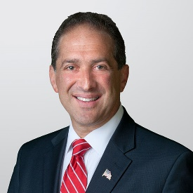

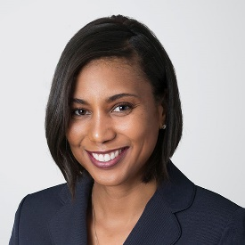
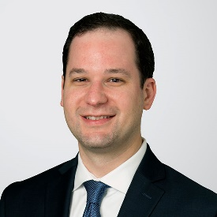
Moderator/Presenters
Ron Klein
Partner | Fort Lauderdale / D.C.
954.468.7874 / 202.469.5152
Ron.Klein@hklaw.com
Scott Mason
Sr. Policy Advisor | D.C. / Charlotte
202.469.5330 / 980.215.7830
Scott.Mason@hklaw.com
Kwamina Thomas Williford
Partner | Washington, D.C.
202.282.1857
Kwamina.Williford@hklaw.com
Mark Francis
Partner | New York
212.513.3572
Mark.Francis@hklaw.com

Slide 5
Anti-Money Laundering and Bank Secrecy Act
Andres “Andy” Fernandez, Gabriel “Gabe” Caballero
& Brian Hayes

Slide 6
Anti-Money Laundering and Bank Secrecy Act
The new administration will be focused and active on AML and BSA enforcement
President Biden views money laundering and its connection to corruption as a national security issue
  “Why America Must Lead Again,” Foreign Affairs, March/April 2020
Pandemic relief funds moving from the government to individuals and businesses through financial institutions
  E.g, 100s of billions through the PPP and EIDL to millions of applicants
Anti-Money Laundering Act of 2020
  Enacted as part of H.R. 6395 (116th): National Defense Authorization Act for Fiscal Year 2021

Slide 7
Anti-Money Laundering Act of 2020
Whistleblower rewards and protections
  AMLA § 6314 rewrites existing BSA award statute, 31 U.S.C. § 5323
  Old: Treasury “may” pay an award capped at $150,000
  New: Treasury “shall” pay an award up to 30%, if sanction > $1M
  Old: Prior BSA whistleblower protection statute, 31 U.S.C. § 5328, repealed
  New: 31 U.S.C. § 5323(g), modeled after Dodd-Frank regime, but employees of NCUA-and FDIC-insured institutions will rely on Title 12 whistleblower protections
Safe harbor for “keep open” requests from law enforcement
  AMLA § 6306 adds section 5333 to Title 31
  No liability or adverse regulatory action if one complies with terms
  Supersede FinCEN guidance notice FIN-2007-G002
New and increased penalties for BSA/AML violations
  AMLA added two new criminal BSA violations to Title 31 for intentionally deceiving or withholding information from financial institutions
  Punishable by up to 10 years' imprisonment and a fine of up to $1 million
  Increased civil penalties for repeat and egregious BSA violators
  Prohibitions on those who commit an "egregious" violation of the BSA from serving on the board of directors of a United States financial institution during the 10-year period after their conviction or entry of judgment
  Other penalty increases

Slide 8
Anti-Money Laundering Act of 2020
Beneficial ownership registry
  Applies to "reporting companies," generally defined as corporations, limited liability companies or similar entities, including foreign entities registered to do business in the United States.
  Those required to register must disclose their beneficial owners, generally defined as those who directly or indirectly "exercise substantial control" over the entity or who own or control more than 25 percent of the ownership interest of such entities.
  The new law directs FinCEN to promulgate implementing regulations within one year of enactment of AMLA.
  Changes to CDD/Beneficial Ownership Rule expected.
  Beneficial ownership information generally cannot be disclosed by FinCEN except to law enforcement and regulators, and to financial institutions for purposes of customer due diligence requirements if authorized by the reporting company.
  Willful failure to file beneficial ownership information can result in civil liability of $500 per day that the violation continues, as well as a fine and imprisonment of not more than two years.
  Those who knowingly make an unauthorized disclosure or use of beneficial ownership information obtained from FinCEN are subject to the same civil liability, as well as a fine and imprisonment of not more than five years.
Pilot Program for Cross-Border Sharing of SAR Information
  AMLA § 6212 requires Secretary of the Treasury to establish rules for a pilot program that would allow the sharing of SARs on an international basis with their non-U.S. affiliates (except for certain affiliates in certain jurisdictions).
Revisions to “financial institution” definition relating to cryptocurrency, dealers in antiquities and the art trade
  AMLA modifies the term “financial institution” to include persons that engage as a business in the transmission of currency, funds, or value that substitutes for currency.
  AMLA expands “financial institution” definition to include persons engaged in the trade of antiquities or sale of antiquities
  AMLA requires study into the facilitation of money laundering and terrorism financing through the art trade.

Slide 9
Anti-Money Laundering Act of 2020
Expanded Authority to Seek Documents from Foreign Financial Institutions
  Subpoenas apply to foreign financial institution that maintain correspondent account in the US
  Broaden authority to include not only records related to such correspondent account, but also to include any account at the foreign financial institution including records maintained outside of the US.
AML Priorities
  Treasury publish priorities for AML compliance
  Requirement to review and incorporate AML Priorities into compliance program which will be a measure on which a financial institution is supervised and examined
OFAC under Biden Administration

Slide 10
What’s the Buzz? Cannabis Banking in 2021
Travis Nelson

Slide 11
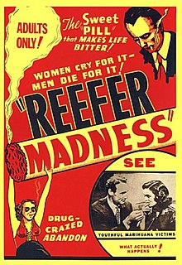

Changing Views on Marijuana
- “Reefer Madness” (1936).
- Cheech and Chong’s “Up in Smoke” (1978).

Slide 12
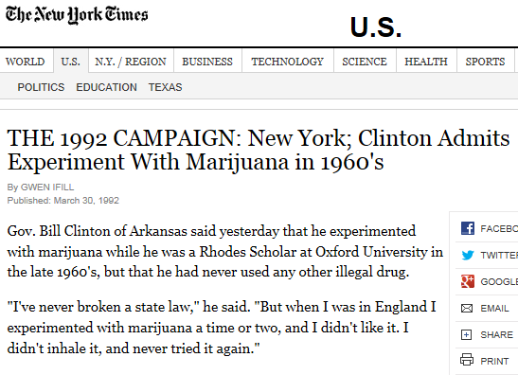
Changing Views on Marijuana

Slide 13
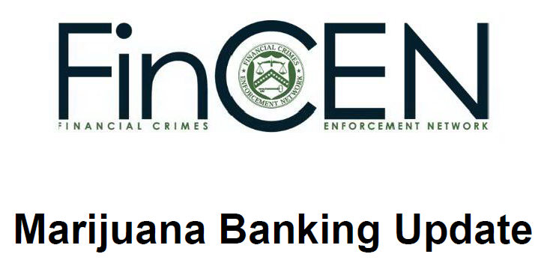
Changing Views on Marijuana

Slide 14




Changing Views on Marijuana

Slide 15
The Current Environment for Cannabis Activities
Federal Controlled Substances Act
SAFE Banking Act; MORE Act
State laws are changing
Views of the courts on marijuana banking/finance, and contracts involving marijuana-related activities
What are we seeing in the industry?

Slide 16
Insurance Regulatory
Beth A. Vecchioli

Slide 17
Insurance Regulatory
Business Interruption claims
COVID liability immunity for essential businesses and workers
Pandemic/virus exclusions in insurance policies
Changes in the property insurance market
Money transmitters and crypto/digital currency

Slide 18
FinServ in a Biden-Harris Administration and Democrat-Controlled Congress
Kwamina Thomas Williford,
Ron Klein & Scott Mason

Slide 19
One Party Control – Sort of
Democrats control the House of Representatives by a very narrow margin, 222-211
The Senate is split 50D-50R, but Vice President Harris = 51
  Democrats may move the vote threshold to 51 votes (eliminate filibuster rules) = easier to pass legislation and nominations.
  Narrow margins in each house will:
    Slow the already deliberative process and limits opportunities for sweeping changes. The market likes stability and predictability.
    BUT this is not a normal time. Congress needs to enact a huge stimulus to avert a deepening recession, but the GOP is suddenly embracing fiscal restraint.
    More interest in actions by the Biden Treasury/Fed appointees and regulators who may act unilaterally to stimulate the economy.
Early Legislative Actions:
  COVID relief legislation
  Large Infrastructure Package
Big Thinking
  Criminal Justice Reform
  Economic Inequality
  Taxes
  Childcare and Healthcare costs
  Immigration

Slide 20
Legislation: What could happen?
Focus on Banking/Financial Services:
  OCC FinTech charters and federal pre-emption in banking
  Small business lending, CDFIs and MDIs
  Credit Score, Credit Bureau
  Fair Lending- disparate impact
  GameStop!!
GSE Reform:
  No real movement in 2021 or 2022.
  Reform on the edges:
    Forbearance discussions driving further thinking- streamline re-fi, servicer support, GSE bailout for CARES Act raised in context of Sec 4022 “fix”
    JUMP START (no recap and release without Congressional approval)
    Direct Oversight of counterparties (Servicers, etc)
New Faces
  Sherrod Brown, new Chair; Crapo replaced by Toomey as Ranking Member
  Some changes on HFSC Dems

Slide 21
Legislation: COVID Stimulus
Senate GOP:
  Let recent $900 billion COVID assistance take root before further action
  May be open to additional assistance for vaccine development and distribution; unemployment insurance extension; direct payment to narrower group of recipients (group of 10 Senators seeking compromise)
Dems:
  $1.9 trillion
  More Payroll Protection Program funds
  Additional thinking on long term small business relief
  State and local government assistance

Slide 22
Biden Appointments
HUD:
  Rep. Marcia Fudge (D-OH)
CFPB:
  Rohit Chopra
  Strong consumer protections, fairness & inclusion
OCC:
  Michael Barr vs. Merhsa Bardaran
FHFA:
  Calabria to…Zandi, Parrott?
SEC:
  Jay Clayton resigns
  Pierce term expires in 2025; Crenshaw’s term expires in 2024; Roisman’s term expires 2023; Lee’s expires 2022
    Fed:
  Jerome Powell's term expires in Feb 2022

Slide 23
Regulatory Environment: Finance
Tax:
  Corporate Rate increase to 23%-28%?
  1st time home buyer tax credit ($15k)
Bank Stimulus:
  Federal program to move nonperforming assets off the book- 2022-2023
  Money Market Mutual Fund help
Cannabis
  Banking, SAFE Act

Slide 24
Regulatory Environment: Financial Services - Consumer Protection
CFPB:
  Rohit Chopra’s confirmation inevitable (Acting Director David Uejio)
  Pro-regulation – “Cordray 2.0”
  Robust enforcement and supervision
  Key focus: COVID-19 (mortgage servicing, auto loans, credit reporting), fair lending, student lending, racial equity
FTC:
  Out: Chopra, Joseph Simons (Acting Director Rebecca Kelly Slaughter)
  Section 13(b) monetary relief under review by SCOTUS: AMG Capital Management, LLC v. Federal Trade Commission
  Key focus for financial services: UDAAP, use of data/targeting, privacy, fair lending, debt collection
  Clear terms and conditions in contracts – understandable by least sophisticated consumer
*Critical to have a robust compliance management system

Slide 25
Privacy / Data Security
Mark Francis

Slide 26
Gramm-Leach-Bliley Act (GLBA): Regs & Regulators
Incident and Notice Guidelines
CFPB: Regulation P
(replaced privacy notice rulemaking authority of the Fed, NCUA, OCC, OTS, FDIC and FTC after Dodd-Frank Act, but they retained enforcement authority)
FTC also retained rulemaking jurisdiction for motor vehicle dealers that are predominantly engaged in the sale and servicing or the leasing and servicing of motor vehicles, excluding those dealers that directly extend credit to consumers and do not routinely assign the extensions of credit to an unaffiliated third party)
Interagency Guidelines (Fed, OCC, FDIC, OTS)
NCUA, SEC, and CFTC issued the same rules
FFIEC IT Examination Handbook
Security Guidelines
Model Privacy Notice
Privacy of Consumer Financial Information
(16 CFR 313)
GLBA
FTC
Standards for Safeguarding Customer Information
(16 CFR 314)
Model Privacy Notice
Model Privacy of Consumer Financial and Health Information Regulation (MDL-672)
State Insurance Regulators
National Association of Insurance Commissioners (NAIC)
Standards for Safeguarding Consumer Information Model Regulation (MDL-673)
Insurance Data Security Model Law (MDL-668) (similar to NYDFS rules)

Slide 27

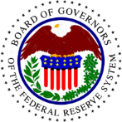

On the horizon for 2021: Incident notification
Notice of proposed rulemaking: Computer-Security Incident Notification Requirements for Banking Organizations and Their Bank Service Providers
Jointly published by the OCC, Federal Reserve, FDIC as 86 FR 2299 (Jan. 12, 2021)
The proposed rule would establish two primary requirements:
Banks must notify a regulator within 36 hours after determining that a notification incident occurred
  The clock does not start ticking until they have “reasonable time” to make that determination
  Notifiable incidents include material impact on operations, finances or a threat to financial stability of the US
Bank service providers must provide immediate notice to 2 individuals at their bank customers of any incident that may impact services for 4+ hours
Takeaways:
Update incident response plans and tabletop exercises to reflect these expectations
Ensure ability to move quickly/effectively at the very outset of an incident to meet these deadlines
  Many organizations are still reacting slowly in initial response to incidents (the first 24-72 hours), even if they tend to proceed effectively once they get moving

Slide 28


On the horizon for 2021: Safeguards Rule
Notice of proposed rulmaking: (1) Privacy of Consumer Financial Information Rule Under the Gramm-Leach-Bliley Act; (2) Standards for Safeguarding Customer Information
Published by the FTC as 84 FR 13150, 84 FR 13158 (March 5, 2019); Workshop held Jul. 13, 2020
Privacy Rule: changes will reflect transfer of most rulemaking authority to the CFPB
Safeguards Rule: adds more detailed requirements for a comprehensive information security program, including an expectation to implement encryption, access controls and multifactor authentication for access to customer data; periodic reports to boards of directors; inventory of customer data and limiting retention; removes “harm” element from incident notice determination.
Expands definition of “financial institution” in both rules to include “finders” who charge a fee to connect prospective consumer borrowers with a lender
Takeaways:
Trend of incorporating NIST guidance into regulations to ensure adequate security controls
FTC and other federal and state regulators will be adopting more express requirements—much like the NYDFS Cybersecurity Rules (NYCRR 500)

Slide 29

On the horizon for 2021: State-specific
California Consumer Financial Protection Law (CA AB1864 (19R), effective Jan. 1, 2021)
“Department of Business Oversight” now the “Department of Financial Protection and Innovation”
Expanded authority to target unfair and deceptive practices under the Dodd-Frank Act (“mini-CFPB”)
90 new dept. positions to be filled
Traditional scope of financial instituitions extended to FinTech products and providers
Already negotiated data-sharing agreements with five payroll advance companies (Even, Earnin, Brigit, Payactiv and Branch) to get quarterly reports detailing consumer fees, complaints, and data on volume of consumers struggling to make payments
But… most focus on privacy in 2021 will be outside the scope of GLBA:
CCPA/CPRA-like privacy laws adopted in other states
Biometric and facial recognition laws
Possible efforts to pass a federal privacy law

Slide 30
On the horizon for 2021: Oversight/Enforcement
The CFPB is expected to ratchet up rulemaking and enforcement across a broad array of priorities, privacy and security is expected to be among them
Other agencies likely to likewise increase enforcement under new administration directives
The SolarWinds event may result in a wide scale review within the federal government and cybersecurity industry on how to approach third party risk management and nation state threats – the financial sector has historically been at the forefront of regulations on these issues
Oct. 1, 2020 guidance on ransomware payments in view of sanctions / AML:
  OFAC: Advisory on Potential Sanctions Risks for Facilitating Ransomware Payments
  FinCEN: Advisory on Ransomware and the Use of the Financial System to Facilitate Ransom Payments
Focus on algorithms and artificial intelligence (AI/ML) impacting consumers
  Issues of equality/privacy may quickly generate significant exposure (have an incident response plan?)

Slide 31
Preserving A/C Privilege in Incident Response
Well-established norms regarding the attorney-client privilege afforded to forensic investigations following cyber incidents have been upended in recent court decisions
See, e.g., In re: Capital One Customer Data Security Breach Litigation, No. 1:19-md-02915, Dkt. 641 (E.D. Va. Jun 25, 2020), Wengul v Clark Hill, No. 19-cv-3195 (D.D.C. Jan. 12, 2021)
Organizations need to operate very carefully to preserve privilege:
  Engagement should be tied to outside counsel, not the business
  Fees covered by legal department, not IT
  Purpose should be specific to legal needs, reports and findings should not be used for IT recovery, remediation or other non-legal purposes
  Disclosures to regulators, senior management, accountant can waive privilege
  Consider the pros/cons of written reports very carefully

Slide 32
Q&A

Slide 33
Thank you! hklaw.com

