Slide 1

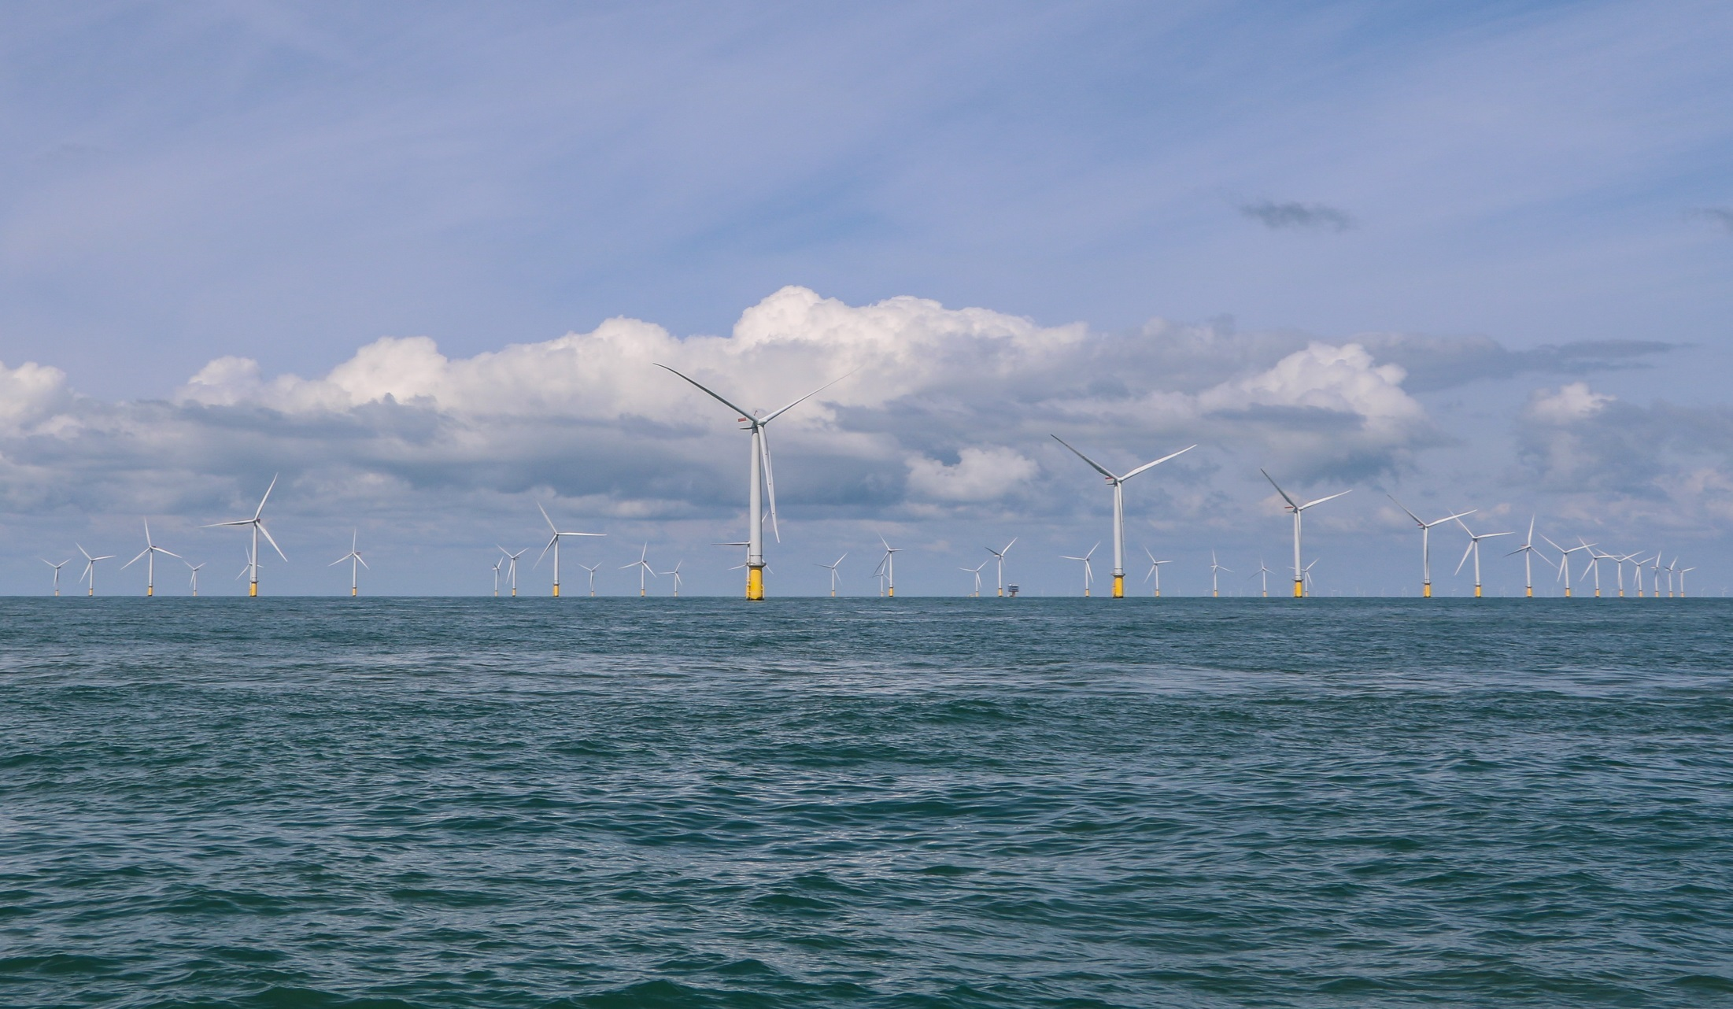


Offshore Wind Project Development:
A Regulatory Update
Author, MARK C. KALPIN
Key considerations
Substantial Progress Has Been Made Over the Last Two Decades
  Technology continues to mature
  Costs / LCOE continue to decline
  Regulatory system has developed
But Much Remains to be Done
Regulatory Improvements Need to be Fully Implemented and Remaining Challenges Timely Resolved for Industry to Reach its Full Potential
Where we started (CAPE WIND)
No Renewable Energy Leasing Program under OCSLA
  Uncertainty over seabed ownership / ability to construct
Section 10 of Rivers and Harbors Act of 1899
  Regulation of obstructions in Navigable Waters
  “Public Interest” standard
Limited State Interest in PPAs / Incentives
Climate Change Concerns not as Pronounced
Technology Not Proven and Still Evolving
RESULT: Major Challenges for Financing and Development of Offshore Wind Projects
WHAT HAS BEEN ACCOMPLISHED
Formal OCSLA Renewable Energy Leasing Program
Development / Refinement of BOEM Regulatory Process
  State-specific stakeholder process
  Project Design Envelope Guidance
  Future: SAP Process / Decommissioning
Streamlining of Federal Permitting Process
  FAST-41 / One Federal Decision MOU
Proliferation of State OSW Programs
  Increased emphasis on addressing climate change
  Desire to capture economic / employment benefits
Improvement in Technology = Reduction in Cost
Remaining challenges to address
Can the Stakeholder Process Produce Consensus?
  Fisheries, navigation, visual, whales, State permitting and CZMA reviews
Will the Regulatory and Permitting Process Improvements Succeed?
  Information sufficiency for NEPA, ESA , MMPA, and NHPA reviews
  Ability to analyze Cumulative Impacts
    Phased development, multiple projects, multiple leases
  Ability to deliver timely / defensible results
Response of Stakeholders
    Will the perfect be the enemy of the good, or can a reasonable compromise be achieved?
What about Transmission?
Ability to Move Beyond State Incentive Programs
CONTACT INFORMATION
Mark C. Kalpin
Partner, Holland & Knight LLP
Phone 617.305.2076 (o) | 617.835.7020 (m)
mark.kalpin@hklaw.com
www.hklaw.com/Mark-Kalpin/

